Slide 1
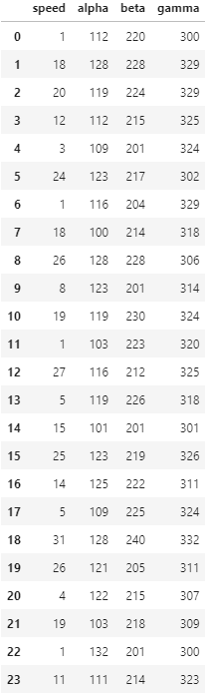
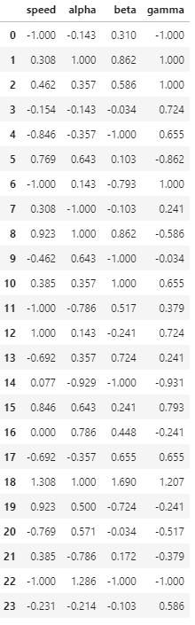
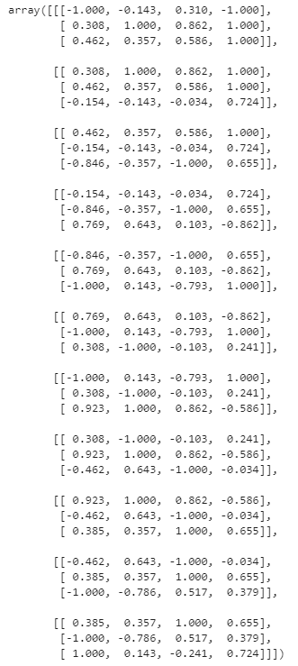
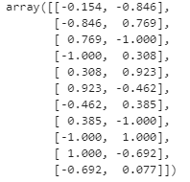
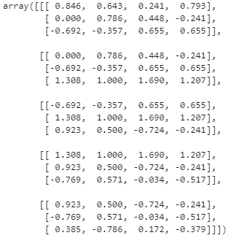

Original Data
Train/Test Split
Min/Max Scaling
Reshape
X_train
y_train
train
X_test
y_test
test

Slide 2
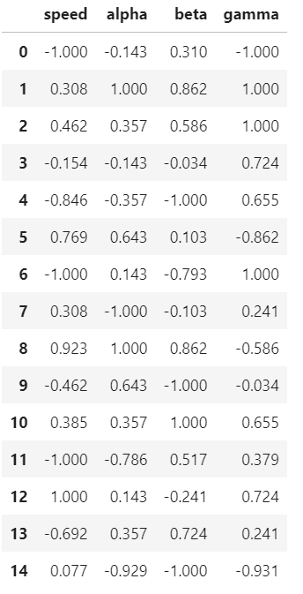
n_batches
X train batch 0
y train batch 0
n_obs
n_dimensions
X train batch 0
n_batches
n_forecast
y train batch 0

Slide 3
n_batches
X train batch 1
n_obs
y train batch 1
n_dimensions
X train batch 1
n_batches
n_forecast
y train batch 1

Slide 4
n_batches
n_obs
X train batch 10
n_dimensions
n_batches
X train batch 10
y train batch 10
n_forecast
y train batch 10

